Slide 1
Innovative test solution
Provider
- Probe pin Datasheet -

Slide 2
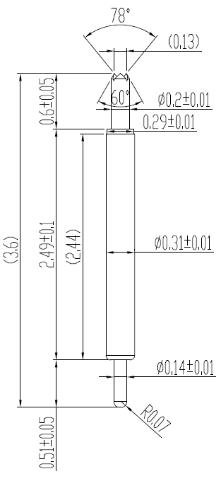
※ Special – POGO pin for High current
IVB-SAR-360-031-A200-00
Pitch | 0.4 mm
Total Length | 3.6 mm
Use Length | 3.3 mm
Use Stroke | 0.3 mm
Recommended Top Plunger Stroke | 0.2 mm
Recommended Bottom Plunger Stroke (Pre-load) | 0.1 mm
Max Stroke | 0.5 mm
Spring Force at Use Stroke | 20 gf at 0.3 mm stroke
Operating Temperature | -40 to +200℃
DC Resistance | Avg. 36.8 mΩ at 0.3 mm stroke
Current Rating (Continuous 1Hour) | 4.7 A
Current Rating (Duty cycle 30%) | 5.5 A
Self Inductance | 0.98 nH
Bandwidth @ -1dB | 27.04 GHz
Top Plunger | BeCu / Pd
Bottom Plunger | BeCu / Au
Barrel | Pb / Au
Spring | SUS / Au
Insertion Life | 200,000 cycles

Slide 3
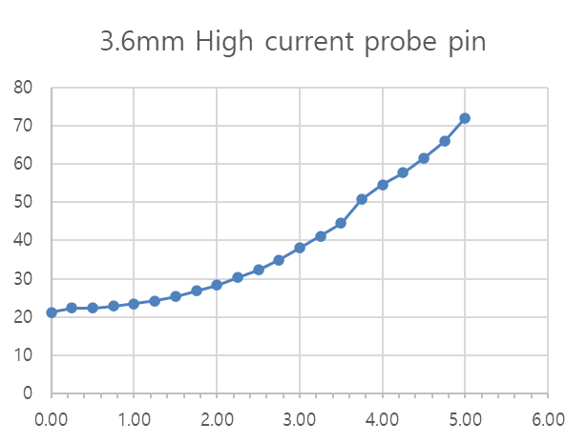
※ Special – POGO pin for High current
3.6mm High current probe pin
Current (A) | Temp. (T)
0.00 | 21.3
0.25 | 22.40
0.50 | 22.40
0.75 | 22.80
1.00 | 23.50
1.25 | 24.20
1.50 | 25.40
1.75 | 26.80
2.00 | 28.30
2.25 | 30.30
2.50 | 32.30
2.75 | 35.00
3.00 | 38.10
3.25 | 41.20
3.50 | 44.50
3.75 | 50.70
4.00 | 54.60
4.25 | 57.70
4.50 | 61.60
4.75 | 65.90
5.00 | 72.10
IVB-SAR-360-031-A200-00
Temperature (°C)
Current(A)

Slide 4
Thank you.

